Slide 1
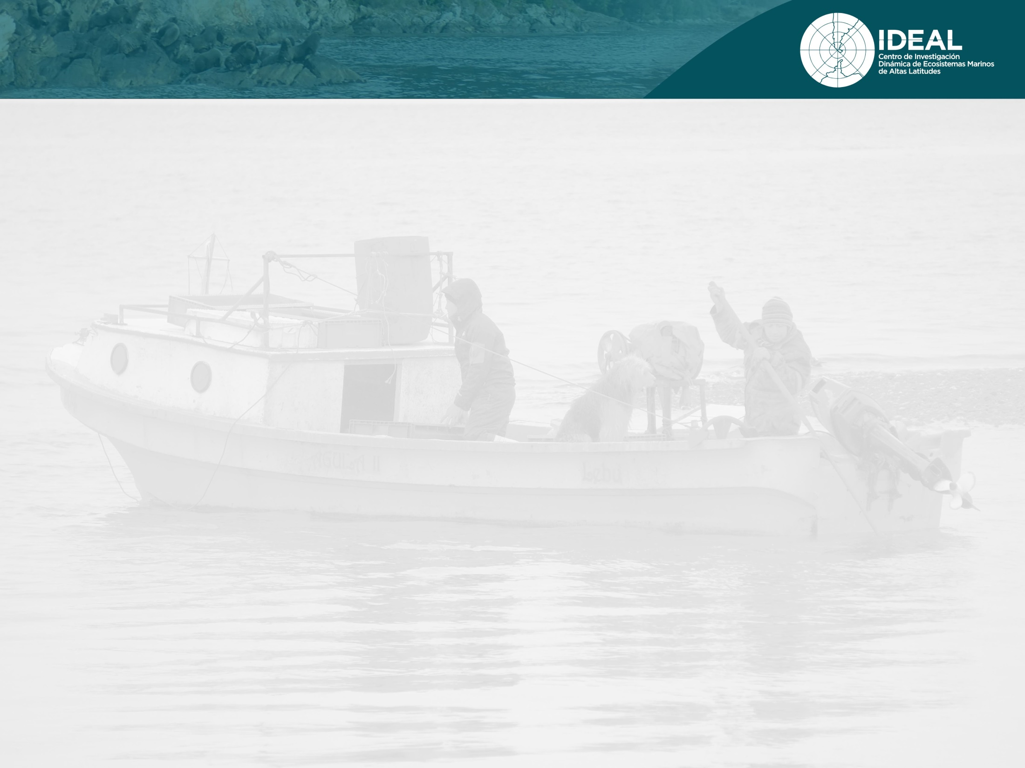
Shaping the measurement of artisanal fishing opportunities under the equity concept
Preliminary and looking for methodological feedback
Luis Outeiro¹, Juliano Palacios Abrantes², Rodrigo Oyanedel^{1,3}, Jonathan Arcos¹ , Laura Nahuelhual^{1,3},
¹ Centro FONDAP de Investigación en Dinámica de Ecosistemas Marinos de Altas Latitudes (IDEAL), Facultad de Ciencias, Universidad Austral de Chile, Valdivia, Chile
²Institute for the Oceans and Fisheries, University of British Columbia, Vancouver, Canada.
³ Instituto Milenio en Socio-Ecología Costera

Slide 2
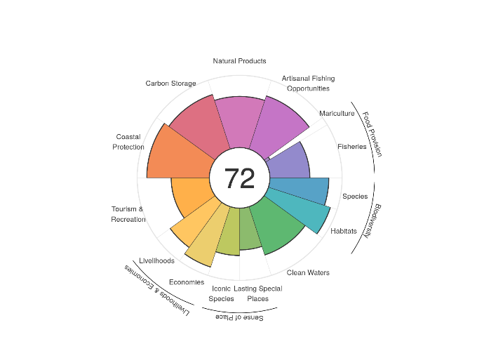
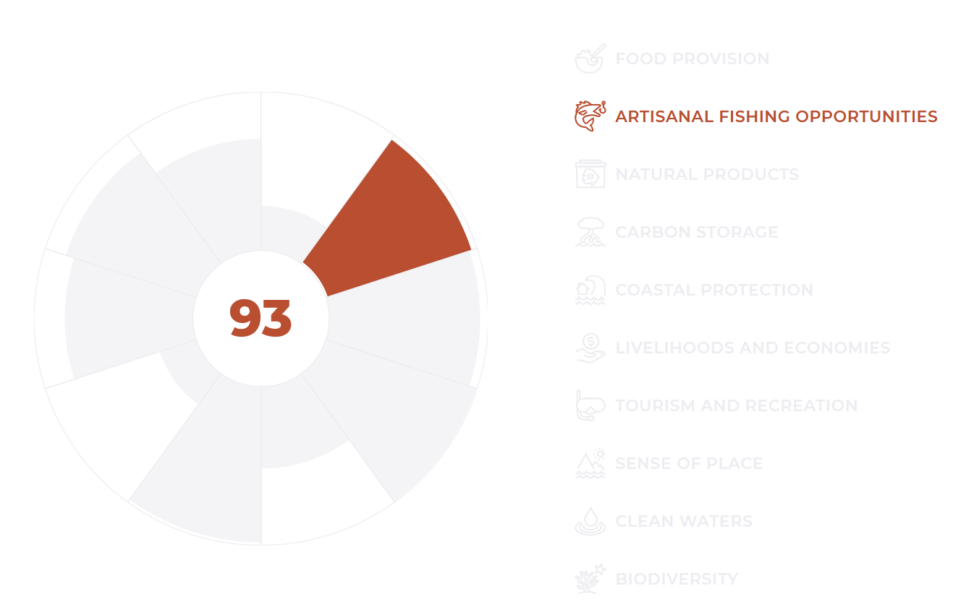
Motivation of the study
There is an increasing need to inform about the health of the marine socio-ecosystems
The need to report with indicators which inform the multidimensionality of fisheries
Global approaches to indicators that estimate opportunity miss local dynamics

Slide 3

The OHI perspective for Artisanal fishing opportunities
The Ocean Health Index is a index that reports ocean health at different scales
The OHI framework bases its index of artisanal fishing opportunities on the economic need for accessing the fishery
What is intended by the idea of ‘opportunity’ is the ability to conduct sustainable artisanal-scale fishing when the need is present, rather than the actual amount of catch or household revenue that is generated.

Slide 4
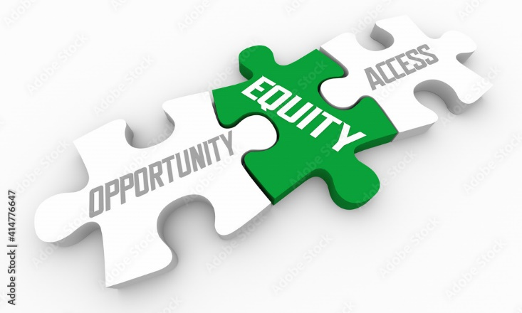
Motivation of the study
Access ≠ Opportunity
We argue that a country which has its access system open and free, it does not mean that equal opportunities for livelihoods and wealth are equal for all of the actors

Slide 5
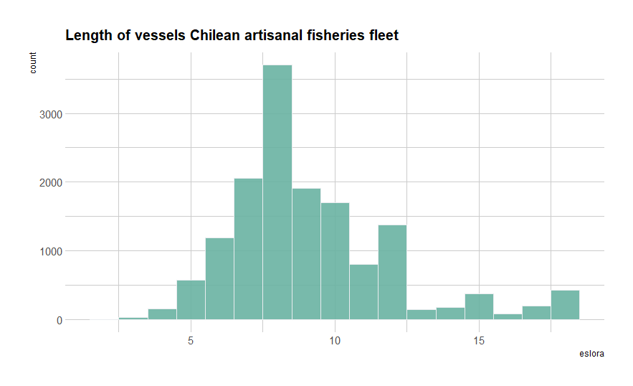
The problem to tackle
Chile has a mixed system of access to fisheries, combining user rights with open access
By law, artisanal fisheries in Chile comprise boats with up to 18 meters of length.
Using Chile as a case study, we develop a new perspective to report the opportunities for artisanal fishing

Slide 6


Artisanal fishing opportunities
OCEAN HEALTH INDEX
x_{ao} : Artisanal fishing opportunities
D_{u} : Unmet demand
S_{ao} : Fishing gear sustainability
PPPpcGDP : GDP adjusted to Power purchasing parity
O_{ao} : Access to artisanal fishing.

Slide 7
Our perspective for measuring Artisanal fishing opportunities
Instead, we base the index of artisanal fishing opportunities on the actual distribution of revenue by fishermen
What is intended by the idea of ‘opportunity’ is the ability to conduct sustainable artisanal-scale fishing when the demand for entering the system and the equal provision of revenue are present and satisfied

Slide 8
The variables to include in the index
Registro Pesquero Artesanal (RPA): from SERNAPESCA Chile, we obtained a data base with the unique ID’s of fishermen
Landings and Prices by species to
Type of gear used and apply coefficient of sustainability
Period of study 2017-2021

Slide 9


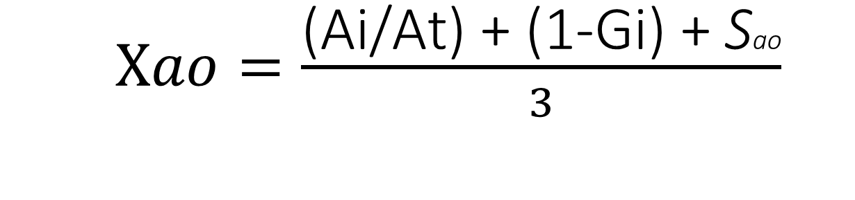
Artisanal fishing opportunities:
Alternative methodology
$Xao=\frac{\text{(}\text{Ai}\text{/}\text{At}\text{) + (1}\text{-}\text{Gi}\text{) + }\text{S}\text{ao}}{3}$
$$Xa$$
x_{ao} : Opportunities
A_{i} : Rate of new fishermen per unit of measurement
G_{i} : Gini coefficient from landing’s revenue.
S_{ao} : Fishing gear sustainability
.

Slide 10

Artisanal fishing opportunities
x_{ao} : Artisanal fishing opportunities
D_{u} : Unmet demand
S_{ao} : Fishing gear sustainability
PPPpcGDP : GDP adjusted to Power purchasing parity
O_{ao} : Access to artisanal fishing.
x_{ao} : Artisanal fishing opportunities
A_{i} : Rate of new fishermen per unit of measurement
G_{i} : Gini coefficient from landing’s revenue.
S_{ao} : Fishing gear sustainability
.

Slide 11
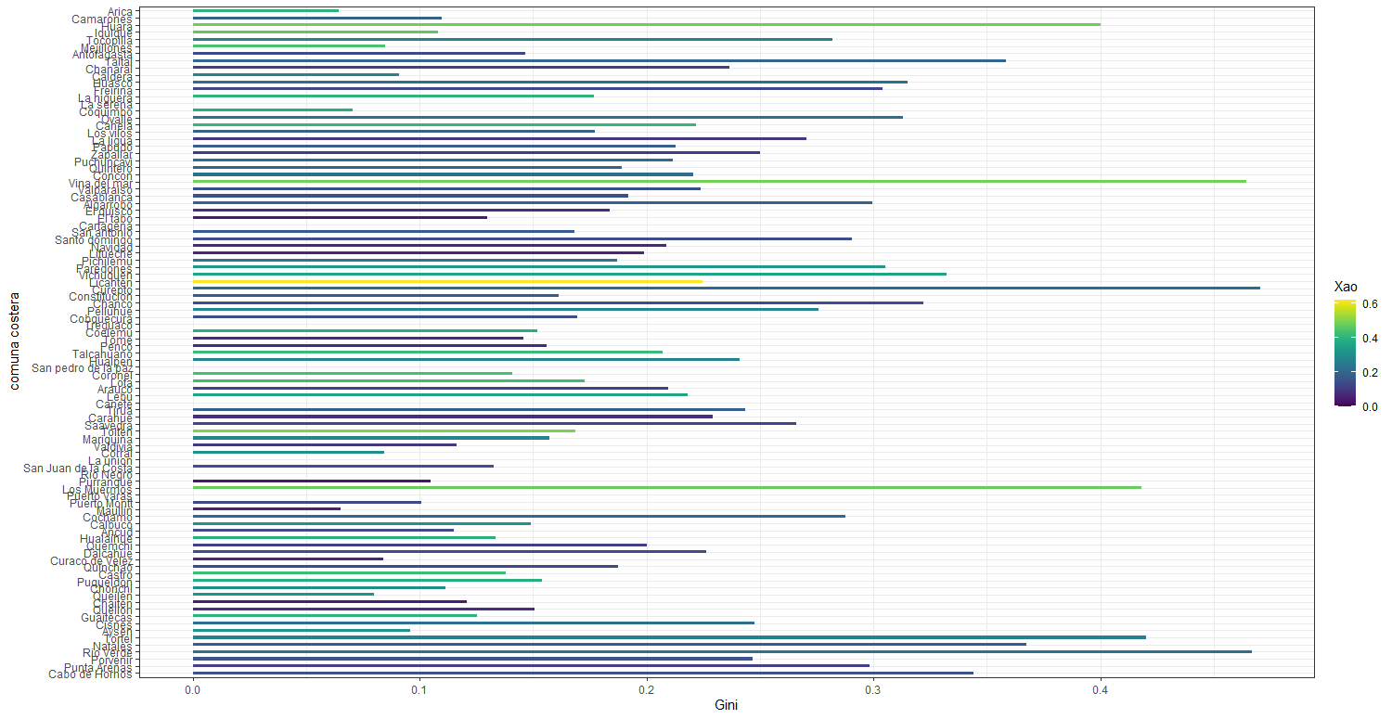
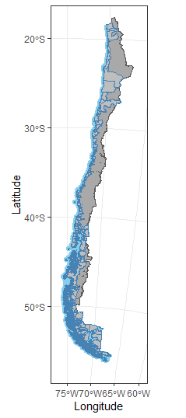
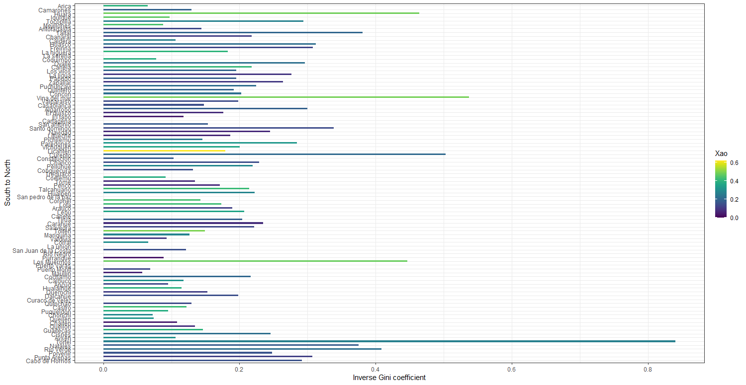

Slide 12
