Slide 1


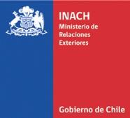
Research Center: Dynamics of High Latitude Marine Ecosystems (IDEAL)
Shaping the measurement of the artisanal fishing opportunities under the equity concept
Luis Outeiro¹, Juliano Palacios², Rodrigo Oyanedel^{1,3}, Jonathan Arcos¹ , Laura Nahuelhual^{1,3},
¹ Centro FONDAP de Investigación en Dinámica de Ecosistemas Marinos de Altas Latitudes (IDEAL), Facultad de Ciencias, Universidad Austral de Chile, Valdivia, Chile
²Institute for the Oceans and Fisheries, University of British Columbia, Vancouver, Canada.
³ Instituto Milenio en Socio-Ecología Costera
MARE, JUNE, 2023

Slide 2
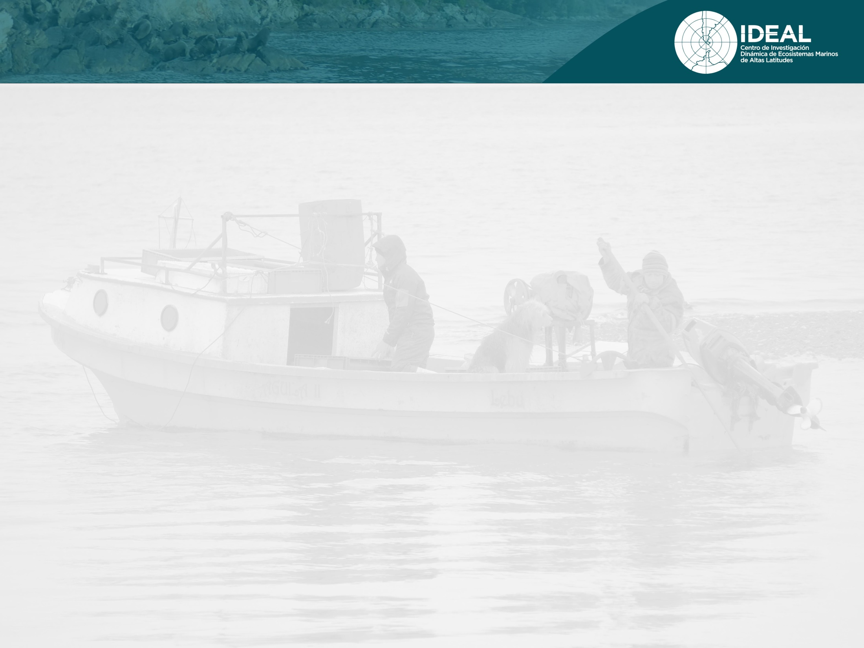
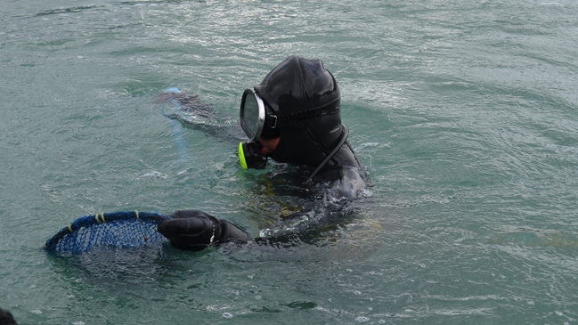
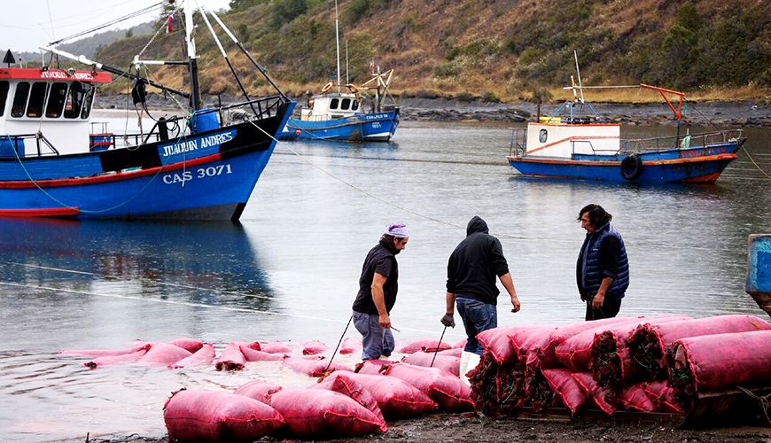
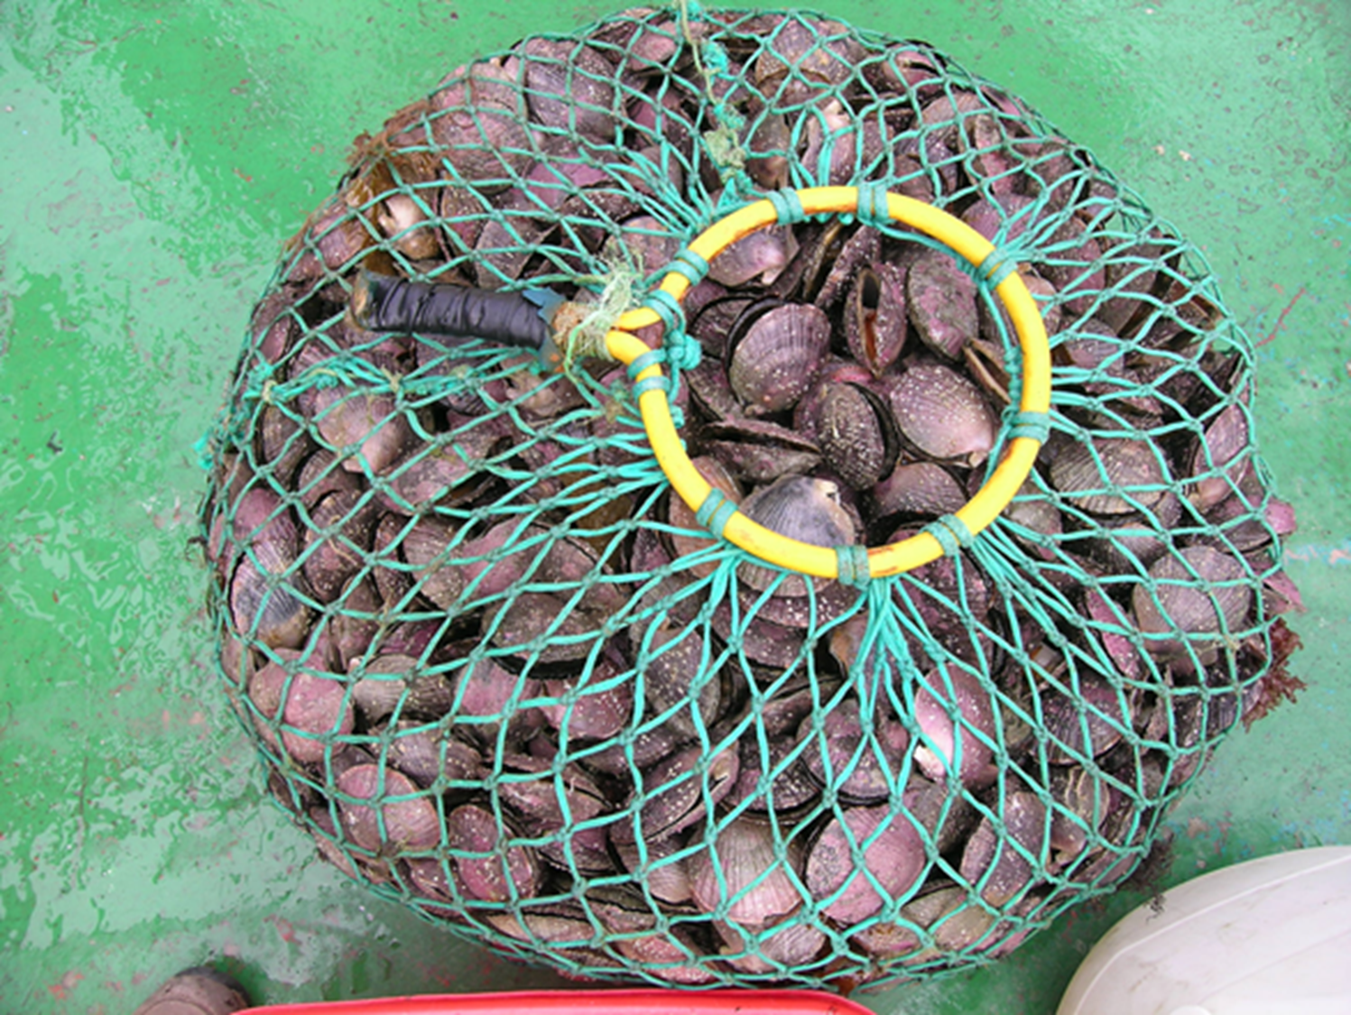
The variables to include in the index
Registro Pesquero Artesanal (RPA): from SERNAPESCA Chile, we obtained a data base with the unique ID’s of fishermen
Landings and Prices by tonnes
Type of gear used and apply coefficient of sustainability

Slide 3
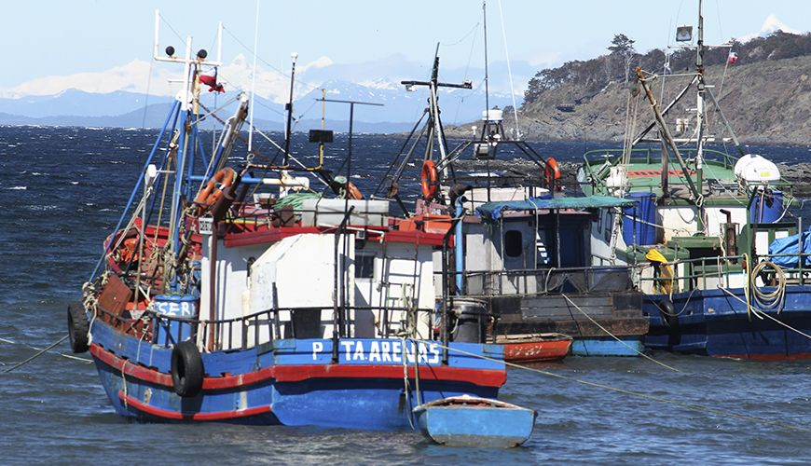
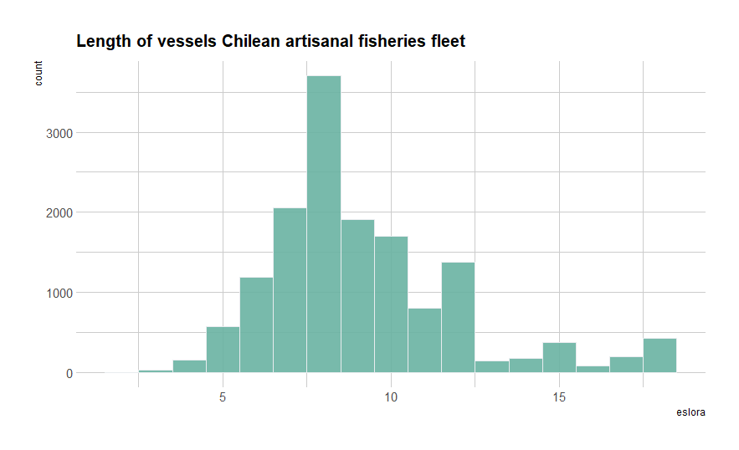
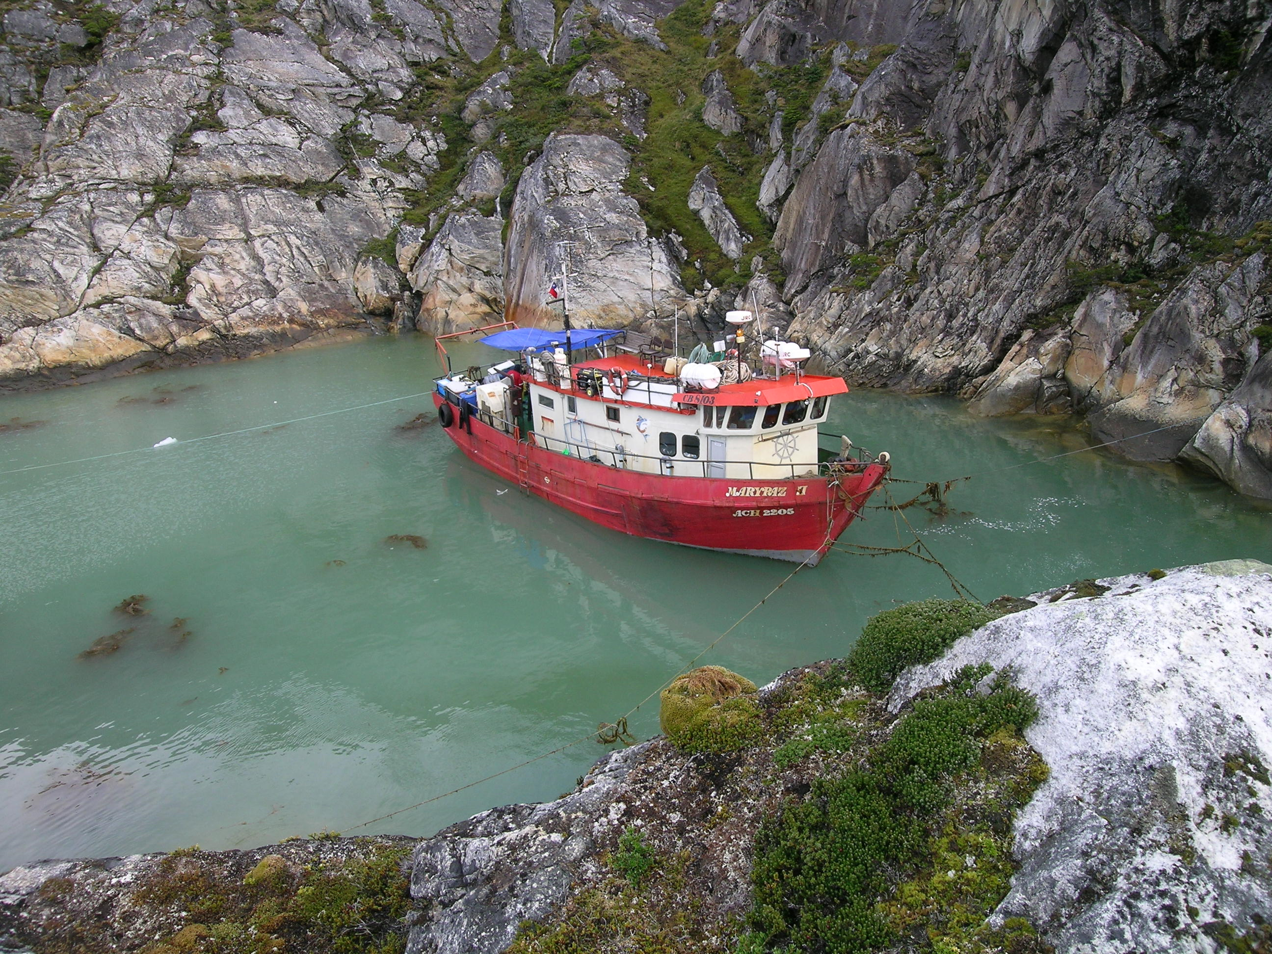
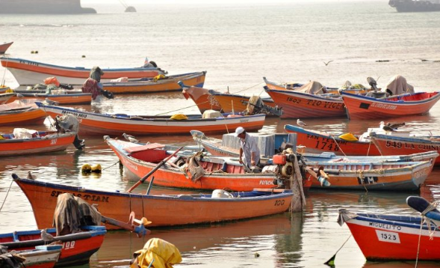
The problem to tackle
Chile has a mixed system of access to fisheries, combining user rights with open access
By law, artisanal fisheries in Chile comprise boats with up to 18 meters of length.
Using Chile as a case study, we develop a new perspective to report the opportunities for artisanal fishing

Slide 5
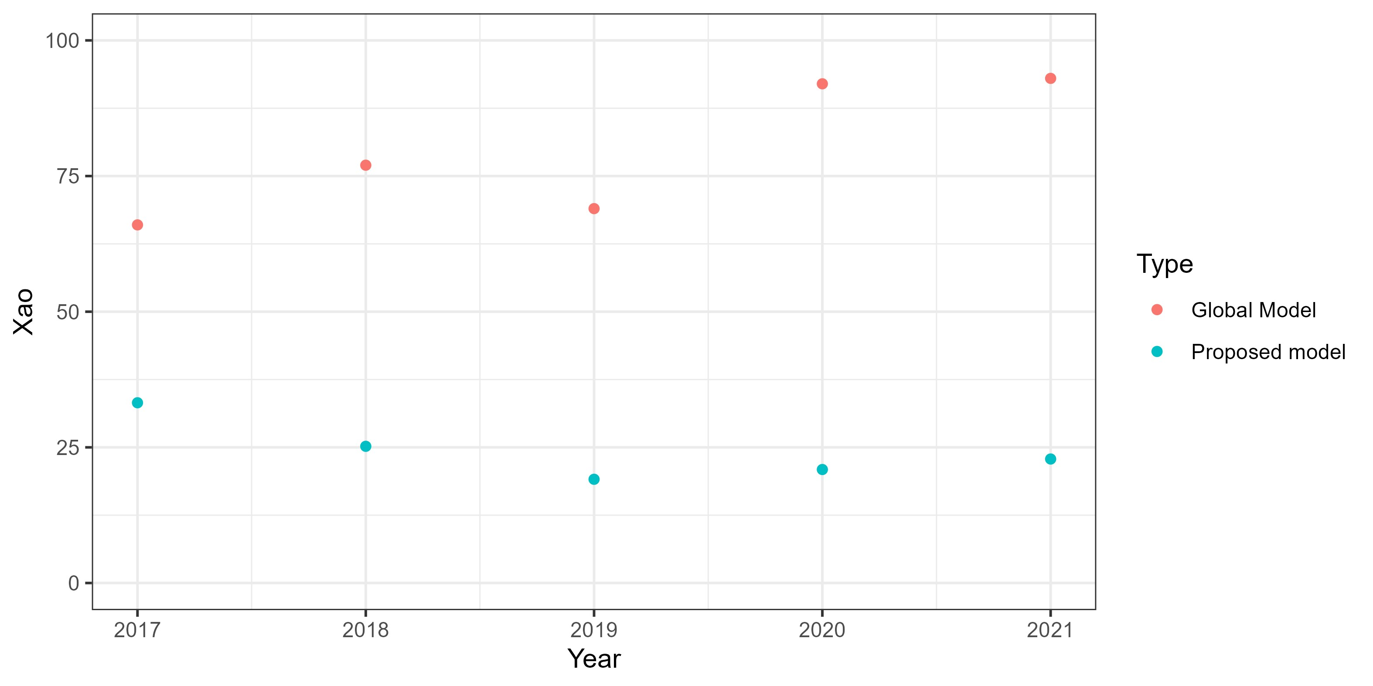

Slide 6



Gracias por su atención ¿Consultas?

Slide 7
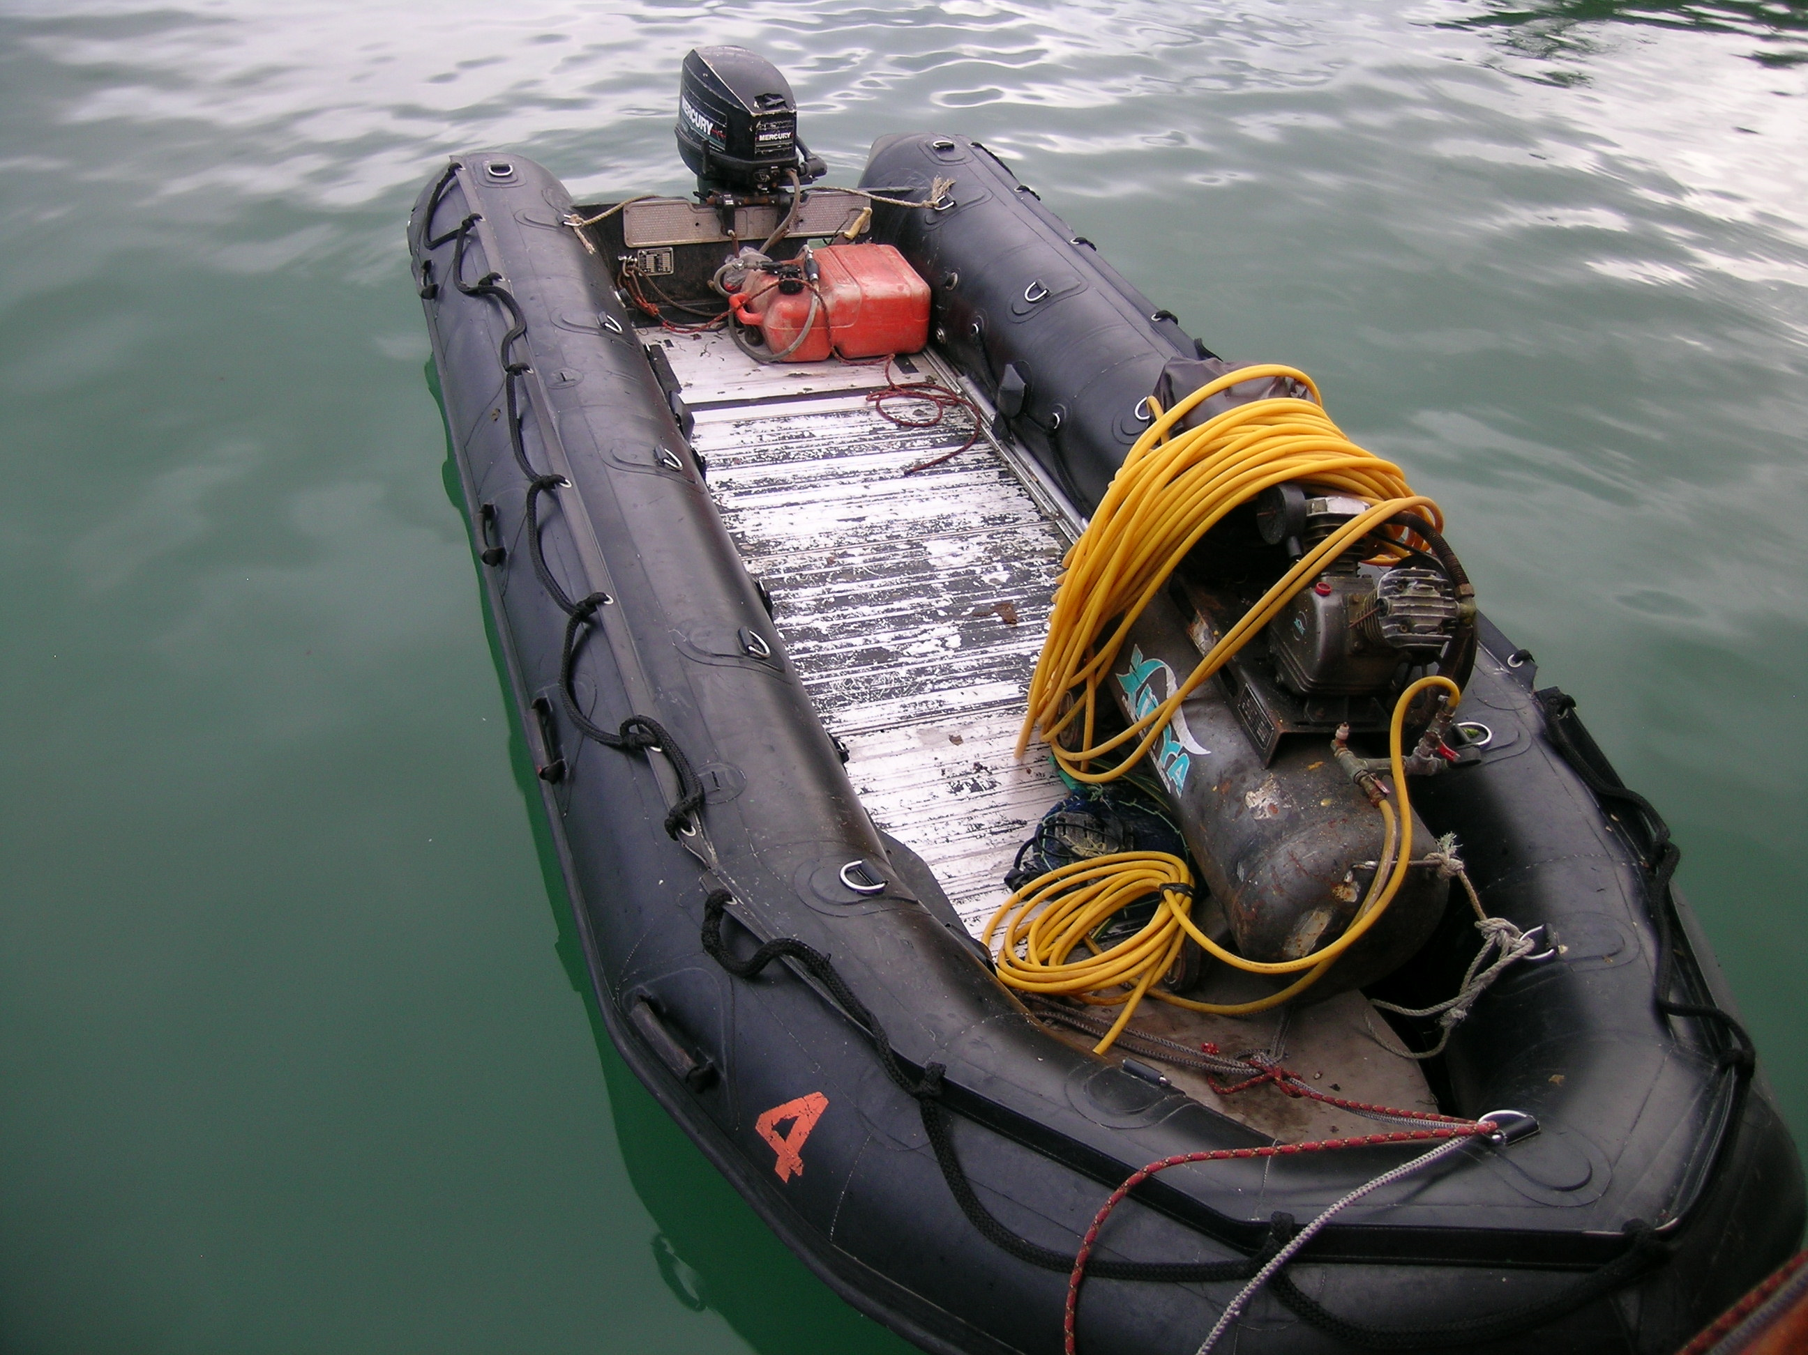
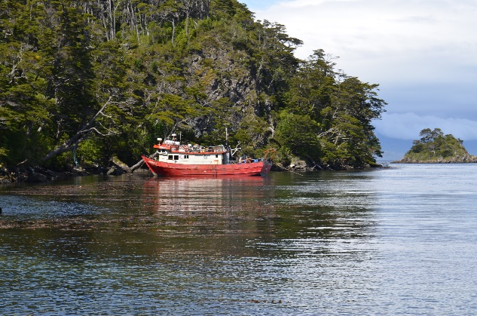

Slide 9
Motivation of the study
There is an increasing need to inform about the health of the marine socio-ecosystems
The need to report with indicators which inform the multidimensionality of the fisheries: the most complex socio-ecological system
The Ocean Health Index as an index to report at different scales

Slide 10
The OHI perspective for Artisanal fishing opportunities
The OHI framework bases its index of artisanal fishing opportunities on the economic need for accessing the fishery
What is intended by the idea of ‘opportunity’ is the ability to conduct sustainable artisanal-scale
fishing when the need is present, rather than the
actual amount of catch or household revenue that is generated.

Slide 11


Artisanal fishing opportunities
OCEAN HEALTH INDEX
x_{ao} : Meta de oportunidad de pescar artesanalmente
D_{u} : Unmet demand
S_{ao} : Fishing gear sustainability
PPPpcGDP : GDP adjusted to Power purchasing parity
O_{ao} : Acceso a la pesca artesanal.

Slide 12

Artisanal fishing opportunities:
Alternative methodology
$Xao$ = $\left(\frac{Ai}{At}\right)$ + $\left(\frac{1}{Gi}\right)$ + S
x_{ao} : Oportunities
A_{i} : Rate of new fishermen per unit of measurement
G_{i} : Coeficiente de Gini para los desembarques.
S_{ao} : Sostenibilidad de los métodos de pesca.

Slide 13
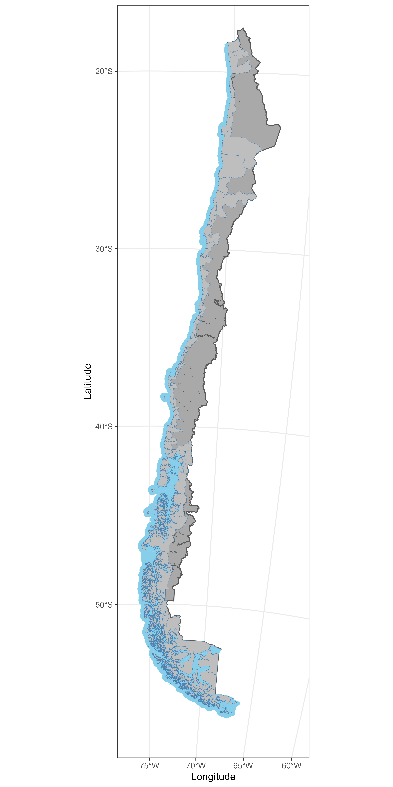

Slide 14
